Slide 1
Veni - A Check-In Mobile App for Veterans
UTD EMSE Spring 2015
February 19th Class Meeting Report
Anant Kambli Brian MacKay Raleigh Murráy Shahed Shuman Kathryn Whitmire

Slide 2
The Physical Architecture
Linux Virtual Machine
Veni-Specific VistA Instance
Remoting
Virtual Machine
Web Service
REST - via HTTPS
with JSON or XML
iOS
Android
Intel, Xamarin or Apache Cordova

Slide 3
Use Cases
We reduced our full Use Case diagram to a “Level 0” diagram
See attached PDF
Key use case remains “Check-in at VA Facility”

Slide 4
High Level Architecture
The high-level architecture remains
A VistA system (or systems)
We’ll set up a dev-sandboxed one in a cloud VM for this project
A middle tier web-service application running in a cloud VM
A phone application that includes logic and UI but no data
We are using a “write once – target all” development environment
The phone app will use the phone’s location services and calendar
See attached PDFs
Package diagram, component diagram, top level class diagram

Slide 5
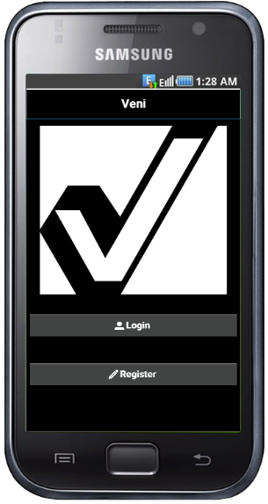
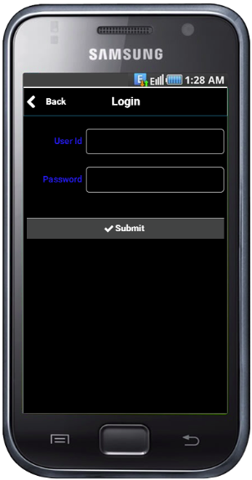
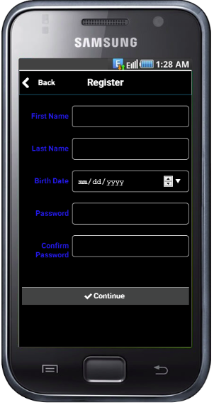
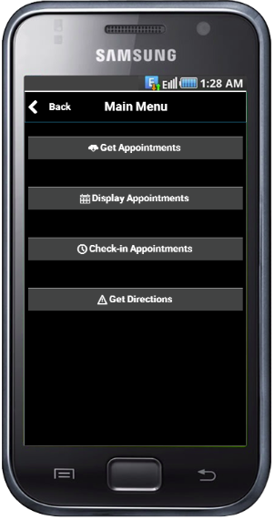
First Stab at Phone UI Prototypes
Splash Screen
Logon Screen
Register User
Main Menu

Slide 6
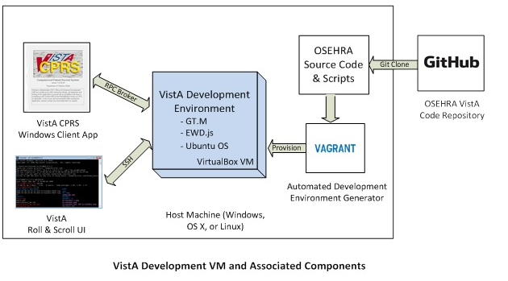
Setting Up Dev-Sandboxed VistA System
Using directions from: http://www.osehra.org/content/how-setup-osehra-vista-development-virtual-machine-vm-0

Slide 7
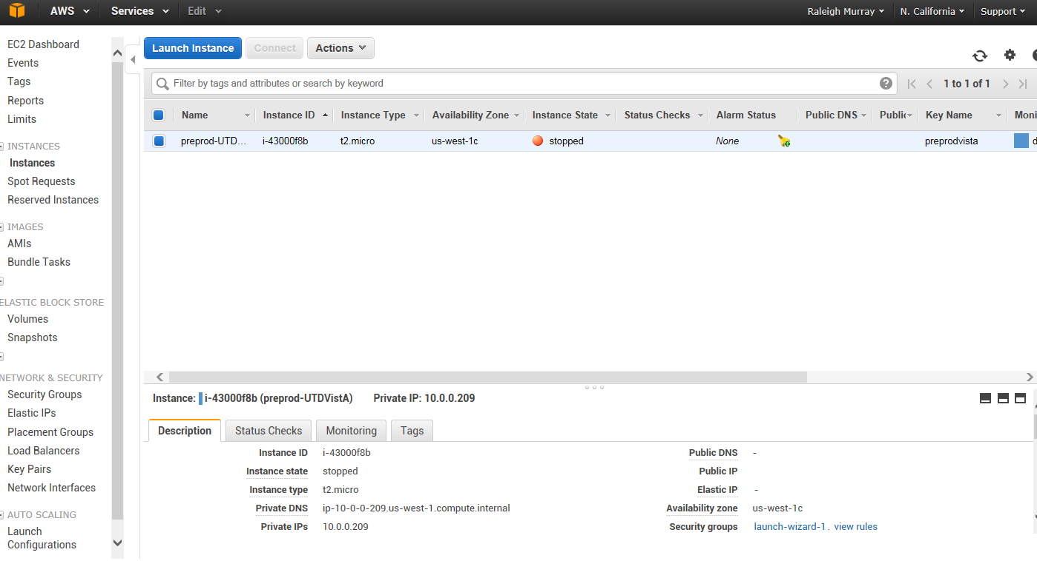
AWS Console with VistA System Running

Slide 8
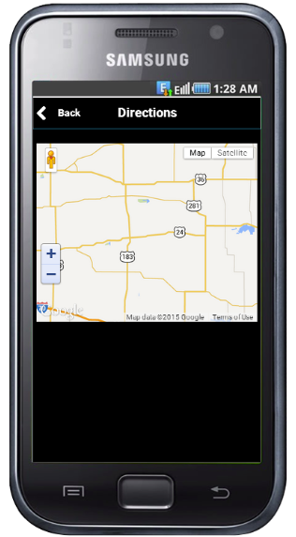
On To the Next Steps

